Slide 1

NGSI-LD Introduction
Jason Fox
Senior Technical Evangelist
FIWARE Foundation

Slide 2
Useful links
What is JSON-LD:
https://www.youtube.com/watch?v=vioCbTo3C-4
JSON-LD Core Markup:
https://www.youtube.com/watch?v=UmvWk_TQ30A
Compaction and Expansion:
https://www.youtube.com/watch?v=Tm3fD89dqRE
JSON-LD Playground & examples
https://json-ld.org/playground/

Slide 3
Linked Context Data: NGSI v2 to NGSI-LD
From: https://fiware-datamodels.readthedocs.io/en/latest/ngsi-ld_faq/index.html
NGSI-LD is an evolution of the FIWARE NGSI v2 information model, and has been updated/improved to support linked data (entity relationships), property graphs and semantics (exploiting the capabilities offered by JSON-LD). This work has been conducted under the ETSI ISG Context Information Management initiative.
Creating proper machine-readable Linked Data is fundamental to NGSI-LD.
NGSI-LD Payloads are valid JSON-LD
{
"@context": [
"https://fiware.github.io/data-models/context.jsonld",
"https://uri.etsi.org/ngsi-ld/v1/ngsi-ld-core-context.jsonld"
],
"id": "http://dbpedia.org/resource/John_Lennon",
"type": "Person",
"name": {"type": "Property", "value": "John Lennon"},
"born": {"type": "Property", "value": "1940-10-09"},
"spouse": {"type": "Relationship", "object": "http://dbpedia.org/resource/Cynthia_Lennon" }
}

Slide 4
What is Core @context?
"ngsi-ld": "https://uri.etsi.org/ngsi-ld/",
"geojson": "https://purl.org/geojson/vocab#",
"id": "@id",
"type": "@type",
"Date": "ngsi-ld:Date",
"DateTime": "ngsi-ld:DateTime",
"Feature": "geojson:Feature",
"FeatureCollection": "geojson:FeatureCollection",
"GeometryCollection": "geojson:GeometryCollection",
"LineString": "geojson:LineString",
"MultiLineString": "geojson:MultiLineString",
"MultiPoint": "geojson:MultiPoint",
"MultiPolygon": "geojson:MultiPolygon",
"Point": "geojson:Point",
"Polygon": "geojson:Polygon",
"GeoProperty": "ngsi-ld:GeoProperty",
"Property": "ngsi-ld:Property",
"Relationship": "ngsi-ld:Relationship",
"ContextSourceNotification":"ngsi-ld:ContextSourceNotification",
"ContextSourceRegistration":"ngsi-ld:ContextSourceRegistration",
"Notification": "ngsi-ld:Notification",
"Subscription": "ngsi-ld:Subscription",
… etc
"coordinates": {
"@container": "@list",
"@id": "geojson:coordinates"
},
"temporalQ": "ngsi-ld:temporalQ",
"throttling": "ngsi-ld:throttling",
"observedAt": {
"@id": "ngsi-ld:observedAt",
"@type": "DateTime"
},
"timeInterval": "ngsi-ld:timeInterval",
"unitCode": "ngsi-ld:unitCode",
"value": "ngsi-ld:hasValue",
"values": {
"@id": "ngsi-ld:hasValues",
"@container": "@list"
},
… etc
"@vocab": "https://uri.etsi.org/ngsi-ld/default-context/"

Slide 5
NGSI-LD: Evolution not Revolution
NGSI v2
Well defined REST API for context data using JSON payloads.
GET, POST and other HTTP verbs do the things you expect
CRUD operations -
/v2/entities endpoint
Augment your context data - /v2/registrations endpoint
Push context data to other services - /v2/subscriptions endpoint
NGSI-LD
Well defined REST API for context data using JSON and JSON-LD payloads.
GET, POST and other HTTP verbs do the things you expect
CRUD operations - /ngsi-ld/v1/entities endpoint
Augment your context data - /ngsi-ld/v1/registrations endpoint
Push context data to other services - /ngsi-ld/v1/subscriptions endpoint

Slide 6
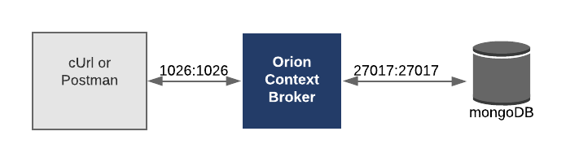
Demo: NGSI-LD - Properties

Slide 7
NGSI-LD Properties: Creating an Entity
NGSI v2
NGSI-LD
curl -iX POST 'http://localhost:1026/v2/entities' \
-H 'Content-Type: application/json' \
-d '{
"type": "Store", "id": "store001",
"category": { "type": "Array", "value": ["commercial"]},
"address": { "type": "PostalAddress", "value": {
"streetAddress": "Bornholmer Straße 65",
"addressRegion": "Berlin",
"addressLocality": "Prenzlauer Berg",
"postalCode": "10439"
},
"metadata": {
"verified": { "type": "Boolean","value": true}
}
},
"location": {"type": "geo:json",
"value": {"type": "Point", "coordinates": [13.3986, 52.5547]}
},
"name": {"type": "Text", "value": "Bösebrücke Einkauf"}
}'
curl -iX POST http://localhost:1026/ngsi-ld/v1/entities \
-H 'Content-Type: application/ld+json' \
-d '{
"type": "Building", "id": "urn:ngsi-ld:Building:store001",
"category": { "type": "Property", "value": ["commercial"]},
"address": { "type": "Property"," value": {
"streetAddress": "Bornholmer Straße 65",
"addressRegion": "Berlin",
"addressLocality": "Prenzlauer Berg",
"postalCode": "10439"
},
"verified": { "type": "Property", "value": true }
},
"location": { "type": "GeoProperty",
"value": { "type": "Point", "coordinates": [13.3986, 52.5547]}
},
"name": { "type": "Property", "value": "Bösebrücke Einkauf" },
"@context": [
"https://fiware.github.io/data-models/context.jsonld",
"https://uri.etsi.org/ngsi-ld/v1/ngsi-ld-core-context.jsonld"
]
}'

Slide 8
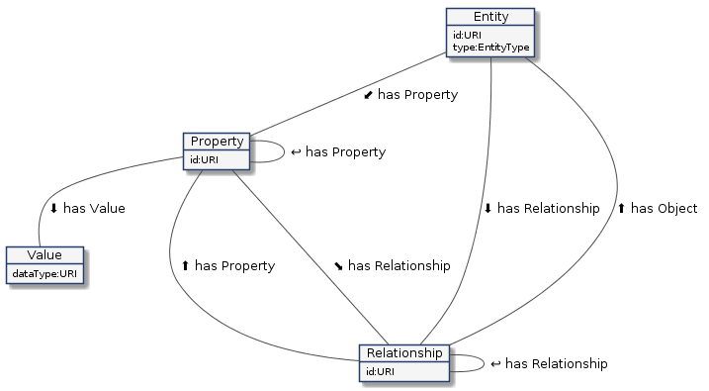

NGSI-LD Properties: Data Model
NGSI-LD
Entities
Properties
Relationships
Values
plus …
plus …
etc...
The NGSI LD data model is more complex; the definitions of use are more rigid which lead to a navigable knowledge graph.
NGSI v2
Entities
Attributes
MetaData
Properties of Properties
Properties of Relationships
Relationships of Properties
Relationships of Relationships
.
Properties of Properties of Properties
Relationships of Properties of Properties
Properties of Properties of Relationships
Relationships of Properties of Relationships
Properties of Relationships of Properties
Relationships of Relationships of Properties
Properties of Relationships of Relationships
Relationships of Relationships of Relationships

Slide 9
NGSI-LD Properties: Data Model
The Entity | Example | Notes
Has an id | urn:ngsi-ld:Building:store001 | URI/URN. id must be unique.
Has a type. | https://uri.fiware.org/ns/ data-models#Building | Fully qualified URI of a well defined data model Short-hand strings for types, mapped to fully qualified URIs through the JSON-LD @context.
Has a series of properties | name, address, category etc. | This can be expanded into http://schema.org/address, which is known as a fully qualified name (FQN).
Has a series of properties-of-properties | a verified field for the address | This is the equivalent of NGSI v2 metadata
Has a series of relationships | managedBy | The object corresponds to the URI/URN of another data entity. Equivalent of NGSI v2 refXXX
Has a series of properties-of-relationships | managedBy.since | Holds additional information about a relationship. This is the equivalent of metadata about a refXXX property
Has a series of relationships-of-relationships | managedBy.subordinateTo | holds the URI/URN of another relationship.

Slide 10
NGSI-LD Properties: Reading Entity Data as JSON-LD
NGSI-LD
Response is just a JSON payload plus an @context
@context can be passed either in the Link header
or the payload body:
Accept: application/ld+json to include
the @context as a JSON attribute
Accept: application/json returns plain old
JSON objects - @context is passed as a Link header
curl -G -X GET \
'http://localhost:1026/ngsi-ld/v1/entities' \
-H 'Link: <https://fiware.github.io/data-models/context.jsonld>; rel="http://www.w3.org/ns/json-ld#context"; type="application/ld+json"' \
-H 'Accept: application/ld+json' \
-d 'type=Building' \
-d 'options=keyValues'
[
{
"@context": "https://fiware.github.io/data-models/context.jsonld",
"id": "urn:ngsi-ld:Building:store001", "type": "Building",
"address": {
"streetAddress": "Bornholmer Straße 65",
"addressRegion": "Berlin",
"addressLocality": "Prenzlauer Berg",
"postalCode": "10439"
},
"name": "Bösebrücke Einkauf",
"category": “commercial",
"location": {
"type": "Point", "coordinates": [13.3986, 52.5547]
}
}
]

Slide 11
NGSI-LD Properties: What to call a location?
"location": {
"type": "GeoProperty",
"value": {
"type": "Point",
"coordinates": [13.3986, 52.5547]}
}
}
NGSI-LD core @context
"@context": {
"ngsi-ld": "https://uri.etsi.org/ngsi-ld/",
"geojson": "https://purl.org/geojson/vocab#",
"id": "@id",
"type": "@type",
"value": "ngsi-ld:hasValue",
... etc.
"GeoProperty": "ngsi-ld:GeoProperty",
"Point": "geojson:Point",
"coordinates": {
"@container": "@list",
"@id": "geojson:coordinates"
},
"location": "https://uri.etsi.org/ngsi-ld/location",
... etc.
}
ubicación ?
standort ?
置き場所 ?
location ✓
place ?
locatedAt ?
geocoordinate ?
geocoordinates ?
With NGSI-LD core @context a location is always https://uri.etsi.org/ngsi-ld/location
Thereafter, with JSON-LD you may map your preferred short name if necessary

Slide 12
NGSI-LD Relationships: Traversing Edge Nodes
Creating proper machine-readable Linked Data is fundamental to NGSI-LD.
From: https://www.w3.org/TR/json-ld/#dfn-graph
A JSON-LD document serializes a dataset which is a collection of graphs
A graph is a labeled directed graph, i.e., a set of nodes connected by edges.
In NGSI-LD:
Node = NGSI Entity
Edge = A relationship attribute linking two NGSI Entities
Therefore NGSI Linked Data relies on three separate definitions:
A definition that a particular attribute within an NGSI entity really represents a link
A machine readable definition of that link in the Data Model (i.e. the @context)
A machine readable definition of the set of all types of links available (the @graph)

Slide 13
NGSI-LD Relationships: 1. Creating Entities
Relationship Links within an NGSI Entity are formally defined using:
"type": "Relationship" OR "@type": "https://uri.etsi.org/ngsi-ld/Relationship"
The attribute of the linked entity is an object rather than a value
curl -X POST \
http://localhost:1026/ngsi-ld/v1/entities/urn:ngsi-ld:Shelf:unit001/attrs \
-H 'Content-Type: application/ld+json' \
-H 'fiware-servicepath: /' \
-d '{
"stocks": { "type": "Relationship","object": "urn:ngsi-ld:Product:001"},
"numberOfItems": {"type": "Property","value": 50},
"locatedIn" : {
"type": "Relationship", "object": "urn:ngsi-ld:Building:store001",
"requestedBy": {"type": "Relationship","object": "urn:ngsi-ld:Person:bob-the-manager"},
"installedBy": {"type": "Relationship","object": "urn:ngsi-ld:Person:employee001"},
"statusOfWork": {"type": "Property","value": "completed"}
},
"@context": "https://fiware.github.io/tutorials.Step-by-Step/tutorials-context.jsonld"
}'

Slide 14
NGSI-LD Relationships: 2. Machine Readable Data Models
Relationship links within the @context are formally defined using: "@type": "@id"
FIWARE Data Models @context
"@context": {
"tutorial": "https://fiware.github.io/tutorials.Step-by-Step/schema/",
"Product": "tutorial:Product",
"Shelf": "tutorial:Shelf",
...etc
"installedBy": {
"@id": "tutorial:installedBy",
"@type": "@id"
},
"requestedBy": {
"@id": "tutorial:requestedBy",
"@type": "@id"
},
...etc

Slide 15
NGSI-LD Relationships: 3. Machine Readable Links
FIWARE Data Models @graph
"@graph": [
{
"@id": "tutorial:Product",
"@type": "rdfs:Class",
"rdfs:comment": [
{"@language": "en", "@value": "Product is sold in a Store."},
{"@language": "ja", "@value": "製品はストアで販売されている物"}],
"rdfs:label": [{"@language": "en", "@value": "Product"}, {"@language": "ja", "@value": "製品"}],
"rdfs:subClassOf": {"@id": "http://schema.org/Thing"}
},
… etc
{
"@id": "tutorial:requestedBy",
"@type": "https://uri.etsi.org/ngsi-ld/Relationship",
"schema:domainIncludes": [{"@id": "tutorial:Shelf"}, {"@id": "tutorial:StockOrder"}],
"schema:rangeIncludes": [{"@id": "schema:Person"}],
"rdfs:comment": [
{"@language": "en","@value": "Object requested by person."},
{"@language": "ja","@value": "人が要求したオブジェクト"}],
"rdfs:label": [{"@language": "en", "@value": "requested by"},{"@language": "ja", "@value": "要求者"}]
},
]

Slide 16
Demo: NGSI-LD - Relationships

Slide 17
NGSI-LD Subscriptions: Creating a Subscription
NGSI-LD
Sample Key-Values Payload
curl -L -X POST 'http://localhost:1026/ngsi-ld/v1/subscriptions/' \
-H 'Content-Type: application/ld+json' \
--data-raw '{
"description": "Notify me of low stock in Store 001",
"type": "Subscription",
"entities": [{"type": "Shelf"}],
"watchedAttributes": ["numberOfItems"],
"q": "numberOfItems<10;locatedIn==urn:ngsi-ld:Building:store001",
"notification": {
"attributes": [ "numberOfItems", "stocks","locatedIn"],
"format": "keyValues",
"endpoint": {
"uri": "http://tutorial:3000/subscription/low-stock-store001",
"accept": "application/json"
}
},
"@context": "https://fiware.github.io/tutorials.Step-by-Step/tutorials-context.jsonld"
}'
{
"id": "urn:ngsi-ld:Notification:60812d06f2ebd727e1c425a8",
"type": "Notification",
"subscriptionId": "urn:ngsi-ld:Subscription:60812c7bf2ebd727e1c425a4",
"notifiedAt": "2021-04-22T08:00:06.741Z",
"data": [
{
"id": "urn:ngsi-ld:Shelf:unit001",
"type": "Shelf",
"locatedIn": "urn:ngsi-ld:Building:store001",
"numberOfItems": 8,
"stocks": "urn:ngsi-ld:Product:001"
}
]
}

Slide 18
NGSI-LD Registrations: Creating a Registration
NGSI LD
curl -L -X POST 'http://localhost:1026/ngsi-ld/v1/csourceRegistrations/' \
-H 'Content-Type: application/json' \
-H 'Link: <https://fiware.github.io/tutorials.Step-by-Step/tutorials-context.jsonld>; rel="http://www.w3.org/ns/json-ld#context"; type="application/ld+json"' \
--data-raw ' {
"type": "ContextSourceRegistration",
"information": [
{
"entities": [
{
"type": "Building",
"id": "urn:ngsi-ld:Building:store001"
}
],
"properties": [
"tweets"
]
}
],
"endpoint": "http://context-provider:3000/static/tweets"
}'
Note that properties is defined in the 1.1.1 NGSI-LD core context
In 1.3.1, it is due to be replaced with two separate attributes - propertyNames and relationshipNames - this change has been made in order to offer full GeoJSON-LD support.
Your context broker may or may not support the updated core context

Slide 19
Demo: NGSI-LD - Subscriptions and Registrations

Slide 20
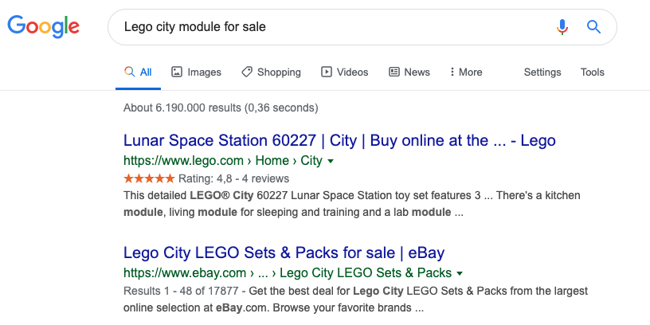

Context Data as Linked Data - How does it help?
Rich Text Snippets
Standard schema.org/Product data model marked up as JSON-LD on the web. Interpreted by third parties. Search Engine can display product rating on screen. System “knows” if a product is out of stock.
NGSI-LD Supermarket Tutorial
Third party ARV could “know” when a shelf needs filling and retrieve goods from the warehouse
No need to reprogram for new customers if data follows the fiware.org/ns/data-models, or the JSON-LD can be converted to do so.

